Slide 1
Using Advanced Machine Learning Techniques to Analyze and Predict the Stock Market
ECGR 4106 - Final Presentation
By: Christian Martens, Jacob Miller, and Kevin Hagler

Slide 2
Agenda
Introduction to the Topic - Predicting the Stock Market
Our Project Statement
LSTM-based Market Prediction
NTM Market Prediction Research
Encoder-based Market Sentiment Analysis
Results and Potential Improvements
References
Questions

Slide 3
A Brief History of Predicting the Stock Market
Since 1792, people have attempted to predict the stock market through a variety of means. Early methods included technical analysis, where traders analyzed charts and past prices to predict future movements, and fundamental analysis, which involved looking at a company's financial statements and economic indicators to estimate its future performance. However, these methods have proven to be unreliable, with the stock market's complexity and unpredictable nature making accurate predictions difficult.
In the modern age, machine learning techniques are being used to analyze and predict the stock market with more accuracy. These techniques involve the use of algorithms to analyze vast amounts of data, including news articles, social media sentiment, and economic indicators, to identify patterns and predict future movements. Machine learning models are also able to learn from past mistakes and continuously improve their predictions, making them more reliable over time. However, while machine learning has shown promise in predicting the stock market, it is not foolproof as even our most advanced models currently are unable to consistently predict the stock market.
Notes:
Source: Wikipedia - League of Legends

Slide 4
Our Project Statement
Using the top grossing U.S.-based companies on the NASDAQ’s historical EOD pricings, we aim to construct models which can analyze current trends and predict the future stock price of a company based on its and other similar stocks’ historical data. These models could be used for personal benefit to gain wealth via stock trading but could also be used by institutions to regulate and monitor the stock market and predict how future legislation could affect the stock market.

Slide 5
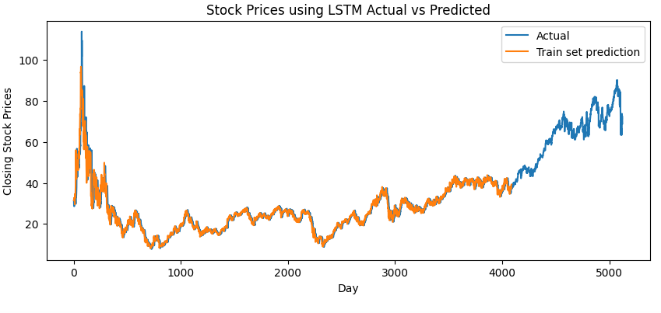
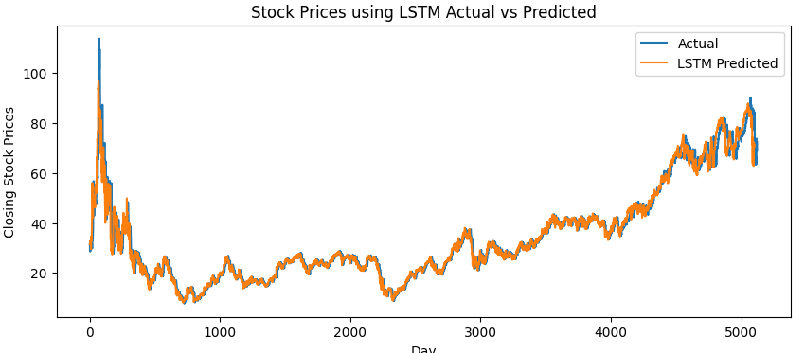
LSTM-based Market Prediction
Training Accuracy 97%
After 50 epochs, the loss was 1.7
Training time was 11:25
Training score was 1.8 MSE

Slide 6
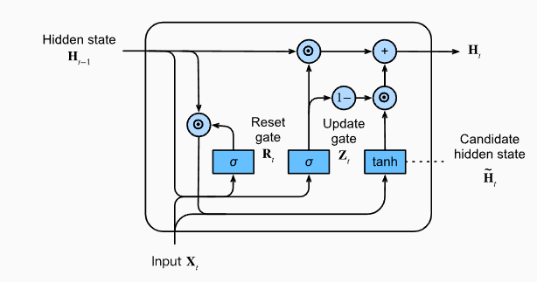
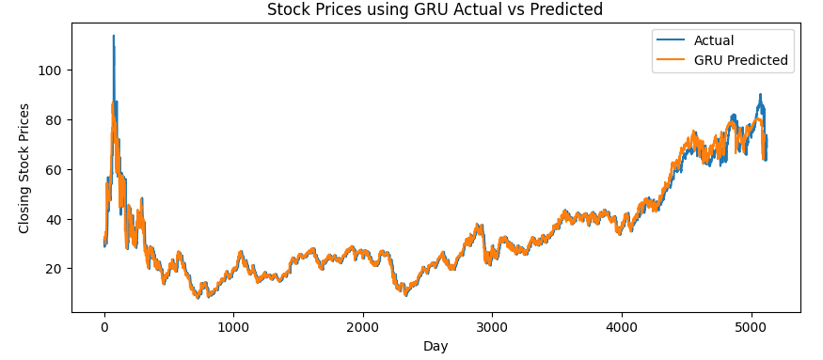
GRU-based Market Prediction
Training Accuracy 94%
After 50 epochs, the loss was 1.8
Training time was 10:23
Training score was 1.7 MSE
One reset and update gate

Slide 7
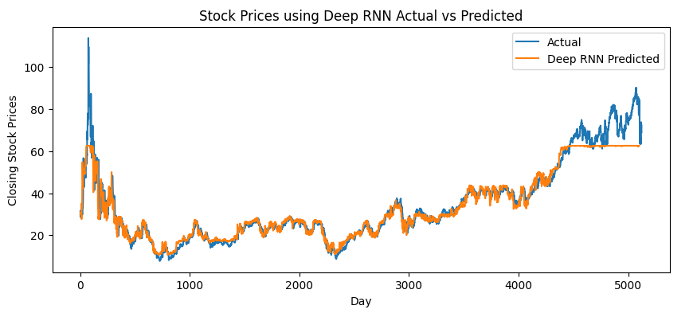
Deep RNN-based Market Prediction
Training Accuracy 75%
After 50 epochs, the loss was 17.5
Training time was 22:30 with a batch size of 2
Training score was 7.1 MSE
Possible vanishing gradient
due to sigmoid function being used.

Slide 8
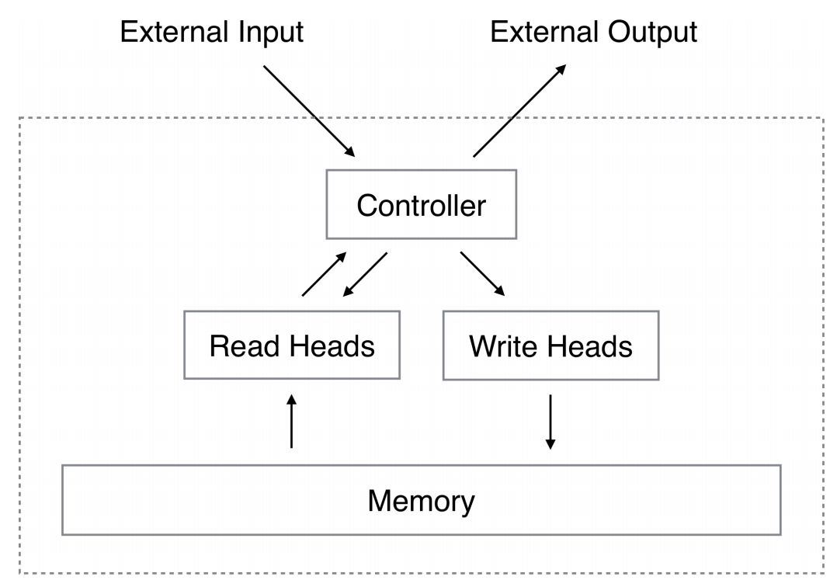
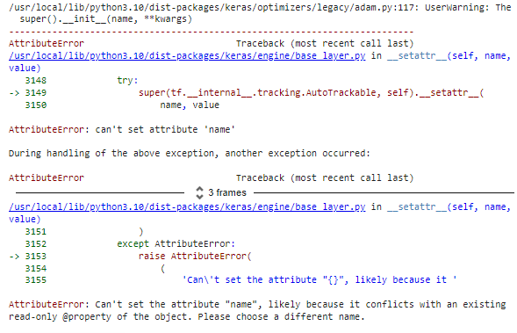
NTM Market Prediction
Research
Tried using an NTM model framework found on Github (https://github.com/flomlo/ ntm_keras/tree/master)
Unfortunately ran into some errors which kept us from compiling the model and receiving results.

Slide 9
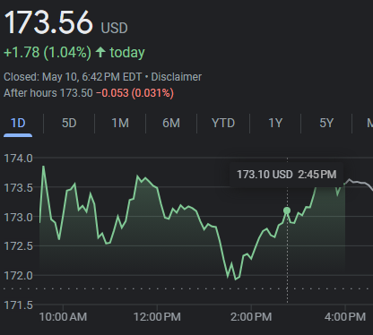
Encoder-based Market Sentiment Analysis
Using Modern Encoding techniques such as Sentiment Analysis, we can now statistically analyze whether or not the Media has an effect on the Stock Market.
Sample Media/News Outlets → Tokenize Samples → Judge Sentiment of Samples → Analyze if Sentiment is related
to the Stock Movement
Notes:
Using Modern Encoding techniques such as Sentiment Analysis, we can now statistically analyze whether or not the Media has an effect on the Stock Market. The process by which we take a lot of information from various news and media sources and compact all that information down into a few measurements of sentiment is a simple-to-follow process. First you need your samples, then you take those samples and tokenize them into a format which the sentiment encoder can recognize. You then process the tokenized samples to determine the overall sentiment of the input which then can be used to predict the stock’s overall movement for that day.

Slide 10
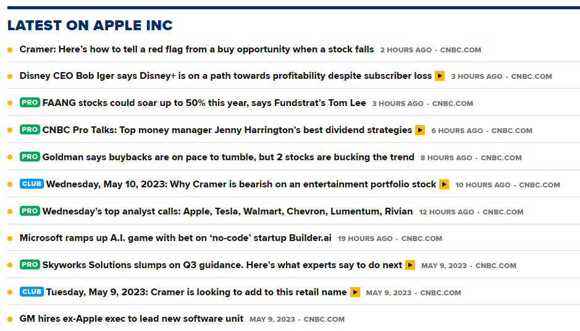
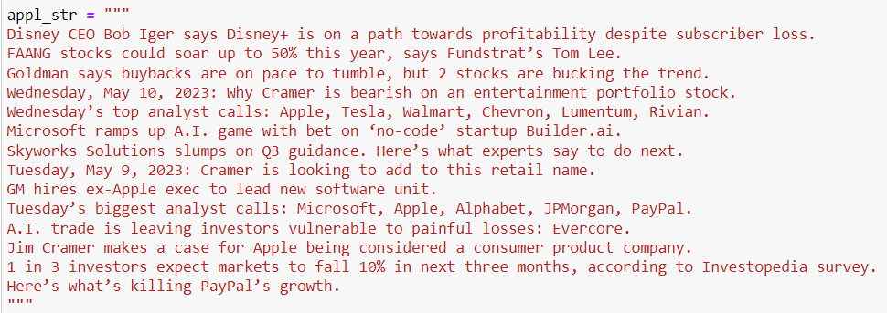
Sample Media Outlets
Using Primarily CNBC and Huffington Post for Samples
Easiest, most complete databases
Notes:
Starting with our media samples, we primarily got ours from CNBC and Huffington Post. These were chosen because their datasets were readily available and complete without too many errors and was a mix of world events, generally coming from HuffPo, and stock market events, generally coming from CNBC. As shown above, this is an example of how we would process a stock like Apple. You would take the headline or summary of the articles that were most relevant to the desired stock (Apple’s in this cas) and store them to be tokenized.

Slide 11
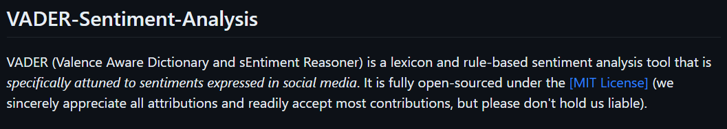
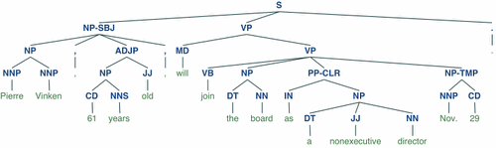
Tokenize Samples
Valence Aware Dictionary and sEntiment Reasoner (VADER)
Trained on MIT Open Database to determine a variety of sentiments
Natural Language ToolKit (NLTK)
Used to tokenize samples for processing
Notes:
For tokenizing our samples, I used NLTK and VADER which are both free libraries that I’ve referenced below. NLTK tokenizes the samples based on grammatical structure as well as other features, and those tokens are then sent to VADER to become encoded with a sentiment score. After taking our datasets compiled from CNBC, HuffPo, and the Stock Exchange and preprocessing them to get rid of errant tokens, the resulting dataset is nearly 5 million tokens large.

Slide 12
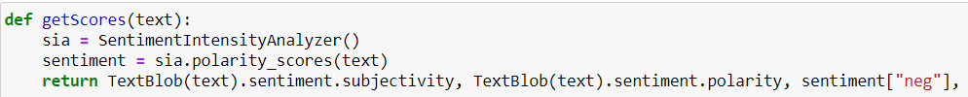
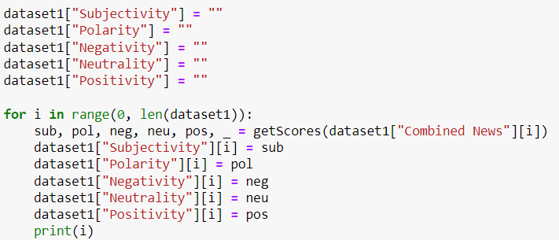
Judge Sentiment of Samples
Notes:
VADER then assigns 5 values to each of the samples; Subjectivity, Polarity, Negativity, Neutrality, and Positivity. Subjectivity is the score of how subjective the language in the given sample is and Polarity is the measure of how polarized/intense the tokens in the given sample are. Negativity, Neutrality, and Positivity are a measure of the negative/pessimistic, neutral/ambivalent, and positive/optimistic nature of the sample. For example, an article titled “Apple is set to make large gains in the next quarter” would score high on the neutral and positive measurements due to the matter-of-fact nature of the sentence but also the optimistic tone/implication of large gains. Together, these measurements can be used to analyze any stock.

Slide 13
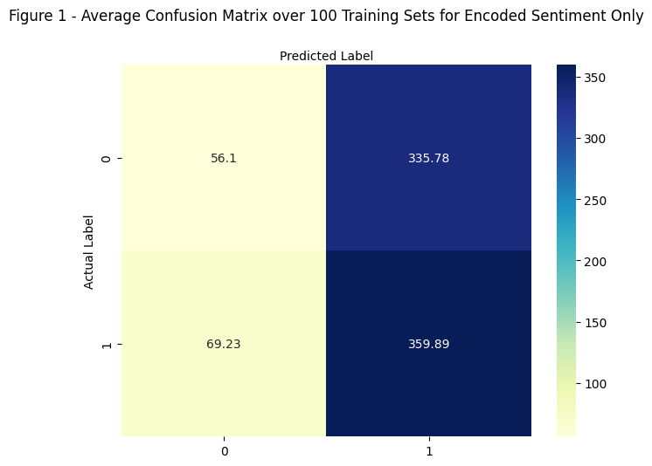
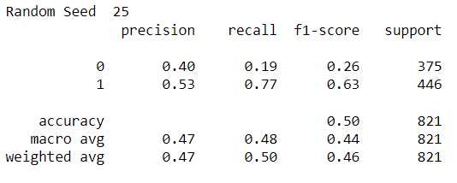
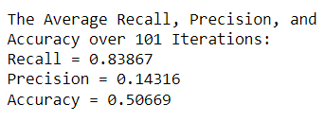
Analyze if Sentiment is related to the Stock Movement
According to these results, using Sentiment Analysis results in no better than a random guess at whether a stock’s price will rise or fall. As such, it can be concluded that the media/news has no significant effect on the stock market.
Notes:
Before we can assess any model, we first need to train one. We use unsupervised learning by taking the historic data for the given stock, which in this case is Apple, and set the label to “1” if the stock’s End of Day (EOD) price is higher tomorrow than it is today and a “0” if the opposite is true. This is because we want to be able to see if there is any correlation between how optimistic the media/news is versus if the EOD increases or not. We then analyze the sentiment measurements against the datas’ labels and compare the results. As shown in the figures here, the overall accuracy of predicting a stock’s movement based on sentiment is very nearly 50%. Since there are only 2 outcomes for this model, the model is no better than a random guess. As such, it can be concluded that the media/news has no significant effect on the stock market.

Slide 14
Results and Future Improvements
Successfully trained LSTM and GRU models to predict future stock prices
LSTM performed better than the GRU model, accurately predicting the future stock rise/fall with 97% accuracy
Analyzed impact of News/Media on the Stock Market
Found no correlation between between the media’s sentiment towards a stock and said stock’s change in EOD price.
Future Improvements include:
Using better/larger variety of media sources to reanalyze
Incorporate other media sources such as YouTube, Twitter, Facebook, etc.
Fine tuning models to try and achieve better accuracies
Further research into different ML models
More research into NTM

Slide 15
References
Hutto, C.J. & Gilbert, E.E. (2014). VADER: A Parsimonious Rule-based Model for Sentiment Analysis of Social Media Text. Eighth International Conference on Weblogs and Social Media (ICWSM-14). Ann Arbor, MI, June 2014.
Bird, Steven, Edward Loper and Ewan Klein (2009), Natural Language Processing with Python. O’Reilly Media Inc
https://www.kaggle.com/code/jacksoncrow/download-nasdaq-historical-data/notebook
https://www.kaggle.com/datasets/jacksoncrow/stock-market-dataset
https://data.world/datasets/twitter
https://www.nasdaq.com/market-activity/quotes/historical
https://github.com/flomlo/ntm_keras/tree/fdfe3ff0e3f5d3e4bc1a2fe51afdf67dae3aa5d8
https://medium.com/analytics-vidhya/rnn-vs-gru-vs-lstm-863b0b7b1573
https://d2l.ai/index.html

Slide 16
Questions?

